Slide 1

Localized Telco Retention: A Geospatial and Financial Risk Analysis (A Data-Driven Strategy Using Network Quality and Targeted Contracts to Reduce Customer Loss)
Sikawura Kobina Ebo Arkorful May 2026

Slide 2

Executive Summary
The Problem: Traditional churn tracking relies on lagging billing data, ignoring real-world physical network quality that directly causes customer loss.
The Innovation: A hybrid tracking model combining customer billing details with active local network performance indicators:
Signal Stability Index
Outage History Score
Competitor Exposure
The Strategy: Tuned a clear, transparent model to prioritize finding at-risk accounts, setting our risk threshold at 0.42 to lock in 85% recall (capturing 85% of vulnerable subscribers).
Key Discovery: Fiber optic lines are our highest risk area. While poor signal stability does not directly cause customer loss on its own, it acts as a secondary trigger that pushes frustrated premium subscribers to cancel.

Slide 3

Introduction & Objectives (Using Network Quality and Financial Data to Eliminate Our Revenue Blind Spots)
The Operational Gap: Traditional tracking systems treat customer loss as a behavioral event based on past billing history, missing the physical infrastructure problems that trigger cancellations.
The Hybrid Approach: Combines standard corporate financial data with active network performance metrics (Signal Stability Index and Outage History Score) to understand the technical causes of customer loss.
The Modeling Goal: Calibrated the model at a 0.4236 custom threshold to achieve our strict business target of 85.0% Recall, ensuring we identify the maximum volume of high-risk accounts early.

Slide 4

Hybrid Injection & Engineering (Combining Location-Based Performance Data with Account Records)
The Foundation: Built using an industry-standard dataset mapping 7,043 unique accounts across 21 baseline characteristics (demographics, billing tiers, and services).
Location-Based Features: Added three location-specific network indicators to capture physical infrastructure health:
Signal Stability Index: Tracks continuous local network reliability.
Outage History Score: Measures the frequency of short-term service drops in the area.
Competitor Exposure: Tracks whether rival providers are actively target-marketing in high-risk zones.
Data Refinement: Added controlled mathematical noise to the signal stability metric. This ensures the model learns broad data patterns rather than memorizing fixed regional averages.
The Test Environment (ZIP 98104): Designated this specific area as a high-stress "Trouble Zone" to explicitly evaluate how regional technical friction impacts customer cancellations.

Slide 5
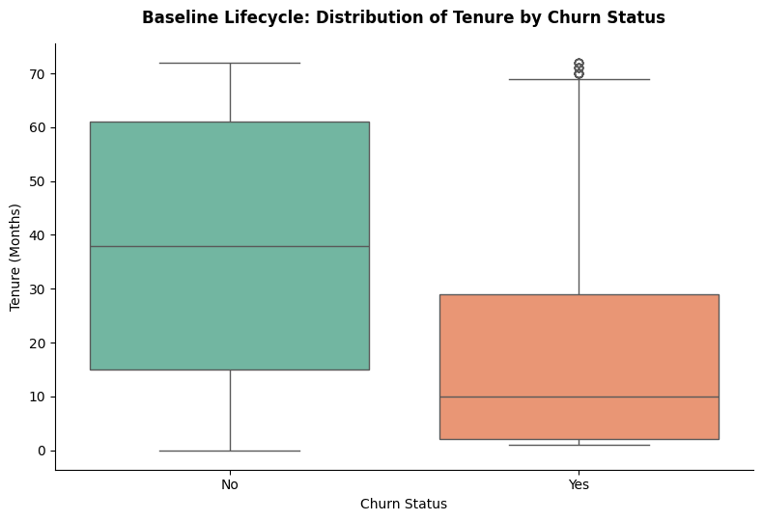
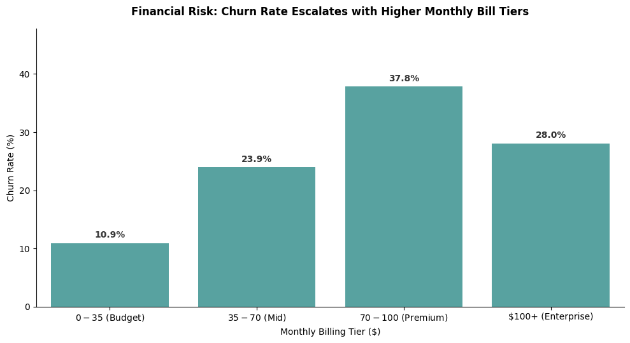
Exploratory Data Analysis (EDA) (The Macro Baseline)
📌 Key Insights:
Early-Stage Vulnerability Window: 75% of all departing subscribers cancel their service within their first 30 months of activation, identifying a critical onboarding and early-lifecycle risk zone.
The Premium Friction Point: Risk does not rise at a steady, fixed rate; instead, customer loss peaks severely at 37.8% within the $70–$100 premium consumer bracket.
Strategic Indicator: High-value premium users maintain strict service-quality expectations. If the physical network's quality fails to justify this higher monthly expense, subscribers rapidly cancel their accounts.

Slide 6
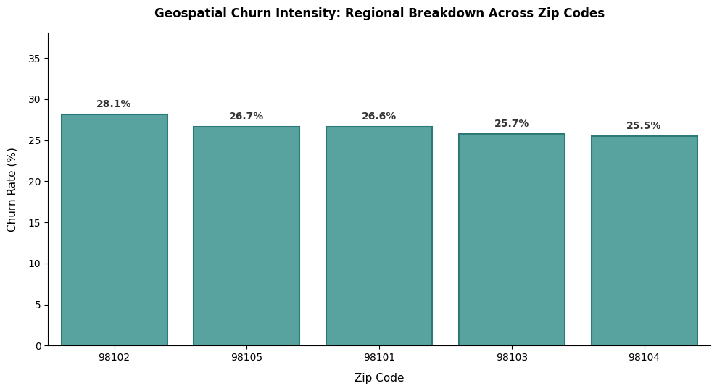
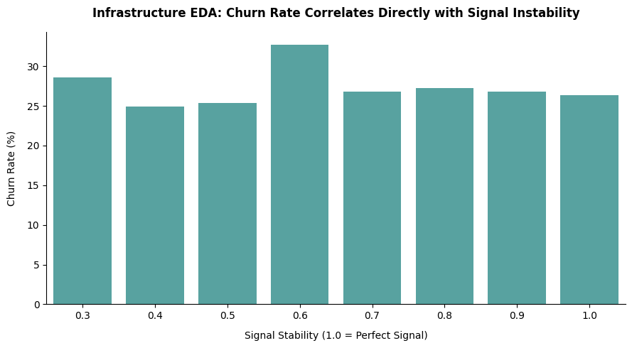
Exploratory Data Analysis (EDA) (Regional Baselines vs. Technical Signals)
📌 Key Insights:
The Regional Baseline: High-level geography shows a remarkably uniform risk across all five postal zones, hovering tightly between 25.5% and 28.1%. Broad regional boundaries alone cannot tell us why customers leave.
The Telemetry Reality: Zooming into network performance reveals that customer loss does not rise steadily as signal drops. Instead, risk remains mostly flat (25%–27%) across almost all performance levels, with an isolated spike to ~32% at the 0.6 threshold.
The Contract Safety Net: Severe signal degradation does not trigger an immediate cancellation. This proves that network drops alone do not drive churn; instead, long-term contracts act as a legal cushion that holds frustrated customers in place temporarily.

Slide 7
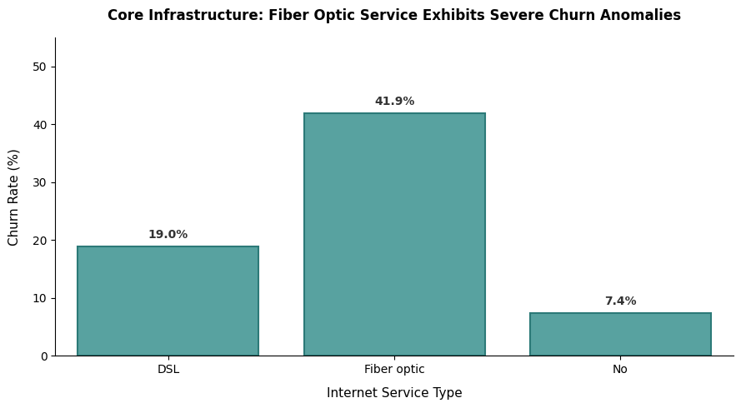
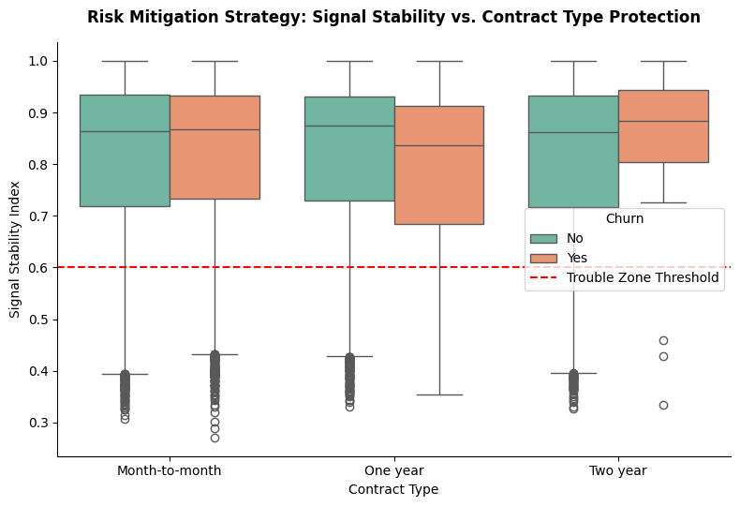
Exploratory Data Analysis (EDA) (Product Ecosystem & Account Constraints)
📌 Key Insights:
The Fiber Optic Paradox: Premium fiber plans require our highest capital investment to build but suffer an alarming 41.9% customer loss rate—more than double that of legacy copper DSL (19.0%).
The Legal Protection Net: Two-year contract agreements act as a highly effective operational cushion. These long-term loyalty commitments temporarily anchor subscribers to our network, even when they experience severe signal drops.
The Hidden Risk: While long-term contracts secure immediate revenue, they can mask underlying network frustration. If these technical signal issues are not proactively fixed before the terms expire, these premium segments represent a high risk for future cancellation.

Slide 8
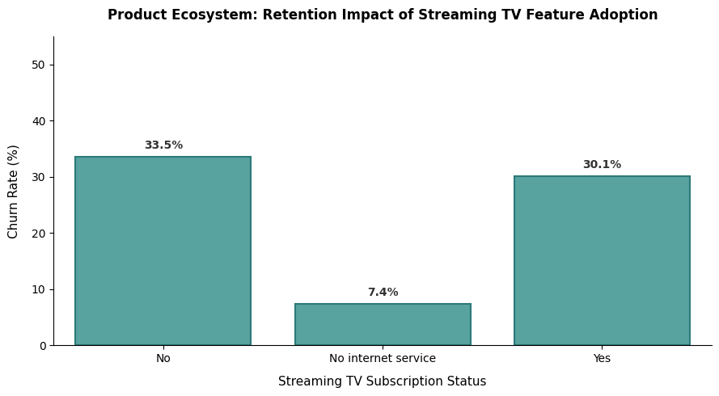
Exploratory Data Analysis (EDA) (Product Ecosystem – Downstream Value-Added Asset Performance)
📌 Key Insights:
Minor Retention Impact: Internet subscribers who do not use Streaming TV have a 33.5% churn rate, while those who add the service drop slightly to 30.1%.
Diminishing Returns: Adding software features onto an existing account only provides a minor 3.4 percentage-point lift in customer retention.
Strategic Takeaway: Selling digital bundles to at-risk accounts yields a low return on investment if the underlying network connection remains unstable. Corporate resources are better spent stabilizing the physical infrastructure.

Slide 9
Preprocessing & Model Tournament (Evaluating Options & Finding Our Champion Architecture)
📌 Key Insights:
Leakage Prevention: Completely separated all customer outcome identifiers from our tracking variables before running any math. This ensures our model mimics a true, unbiased business environment.
Standardizing Data Columns: Processed all customer categories into numerical indicators, creating a clean, uniform matrix of 36 distinct indicators to evaluate behaviors.
The Strategic Trade-Off: While the Gradient Boosting model scored a tiny fraction higher (0.8461 AUC), we deliberately chose Logistic Regression (0.8449 AUC) as our champion.
Why Transparency Matters: A 0.12% accuracy gain is not worth deploying an uninterpretable "black-box" system. Logistic Regression provides completely transparent weights that allow our engineering, supply chain, and marketing teams to trace risk directly to specific infrastructure issues or contracts.
Model | Hyperparameters | Mean ROC-AUC (CV) | Strategic Rationale and Status
Logistic Regression | penalty: elasticnet, C:10, L1_ratio : 1.0 | 0.8449 | Selected Champion: Offers the best balance of clear business transparency and strong predictive power.
Gradient Boosting | n_estimators: 100, learning_rate: 0.1 | 0.8461 | Baseline Benchmark: The highest raw score but maintained for architectural risk comparison.
Random Forest | n_estimators: 200, max_depth: 10 | 0.8295 | Lowest raw score but used for comparison.

Slide 10
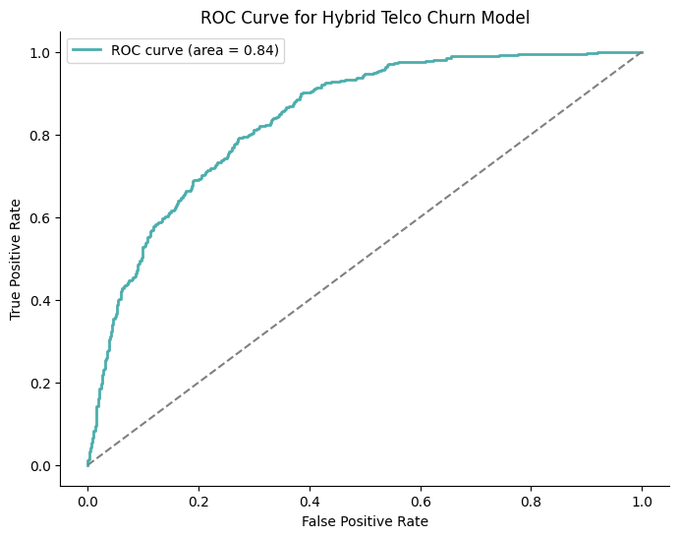
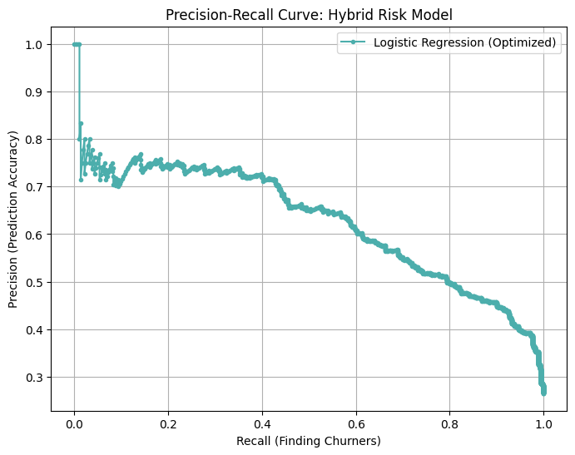
Model Performance & Decision Threshold (Setting the 0.42 Risk Threshold to Catch 85% of At-Risk Account)
📌 Key Insights:
Strong Predictive Accuracy: The model achieved a robust 0.8410 Area Under the Curve (AUC) score. This high metric proves the model has strong predictive reliability, successfully separating high-risk customer profiles from stable baseline subscribers.
Calibrating the Risk Threshold: We intentionally moved our decision threshold down to a 0.42 probability score to optimize our safety coverage and capture vulnerable accounts early.
The Defensive Business Trade-Off: This aggressive boundary holds our model's precision at 47.0% to guarantee that we successfully catch 85.0% of all at-risk accounts (Recall).
Cost-Effective Security: While a lower threshold increases false alarms, the minor operational expense of a proactive retention check is vastly lower than the steep cost of losing premium customer revenue.

Slide 11
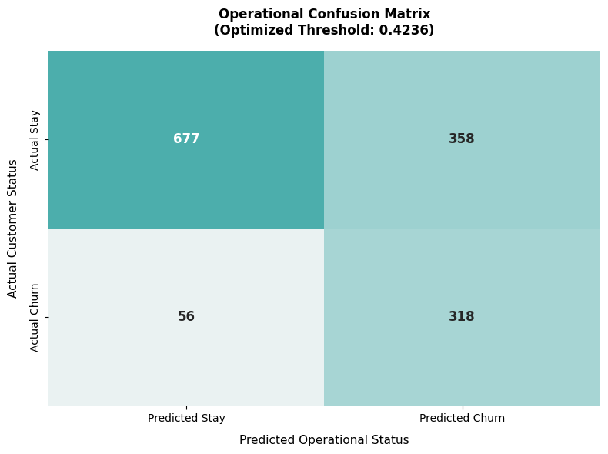
Operational Impact (Confusion Matrix Volume Analysis)
📌 Key Insights:
318 Confirmed Saves (True Positives): The model successfully identifies and flags 318 high-value subscribers before they leave, allowing customer success teams to deploy targeted retention offers early.
Tight 15% Miss Rate (False Negatives): The system completely overlooks only 56 accounts out of the entire churning group. Keeping our blind spot down to a minor 15% rate minimizes sudden, unpredicted revenue losses.
358 False Alarms (False Positives): The model flags 358 stable subscribers as risk profiles. While this introduces a small amount of extra outreach, sending a low-cost contract renewal incentive or automated signal check to a stable line is vastly cheaper than absorbing account replacement costs.
Protects the Core Business: This structure ensures our retention resources are concentrated heavily on the highest-risk revenue brackets, moving the company away from costly, blanket discounting strategies.

Slide 12
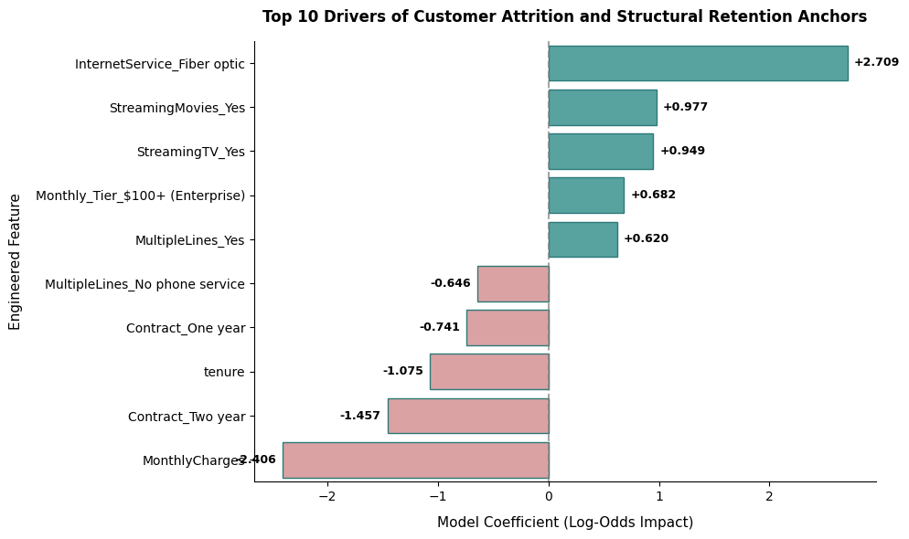
Key Risk Drivers & Retention Anchor (Understanding What Triggers Cancellations vs. What Locks in Loyalty)
📌 Key Insights:
The Premium Infrastructure Friction Core: Having a premium Fiber Optic plan is the single strongest predictor of customer cancellation across the entire model (+2.709 value weight). High-paying subscribers react strongly to any performance friction.
The High-Value App Segment: Heavy usage of digital products like streaming movies (+0.977) and streaming TV (+0.949) heavily accelerates customer risk when paired with premium billing tiers exceeding $100 per month (+0.682).
Our Strongest Defense Lines: Long-term contractual commitments act as the business's most powerful defensive retention tool. A Two-Year Contract (-1.457) and long cumulative customer tenure (-1.075) strongly secure revenue and keep subscribers in place.
The Contract Masking Effect: High continuous monthly charges display a large negative value weight (-2.406). This reveals an interaction effect: when high-spending accounts are secured by two-year agreements, their high spend actually acts as a loyalty anchor rather than a risk factor.

Slide 13

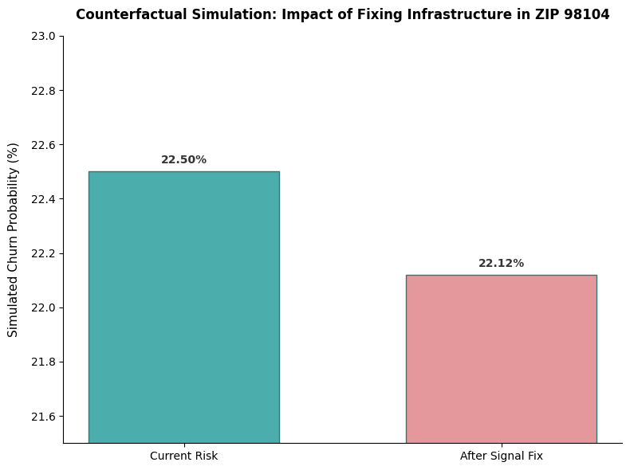
Scenario Simulation & Financial ROI (Evaluating Capital Expenditures to Stabilize Local Customer Risk)
📌 Key Insights:
The "What-If" Scenario: Simulated a localized field repair strategy inside our highest-risk network corridor: ZIP Code 98104. The model tested the impact of raising the local signal stability index from a failing 0.45 up to an optimal 0.80.
The Modest Financial Return: Improving the network signal drops the regional customer risk from 22.50% down to 22.12%. This yields a positive but very modest 1.69% relative risk reduction.
Confirming the Secondary Trigger: This modest 1.69% reduction confirms our data analysis: signal quality alone is not the primary cause of customer cancellation. It acts as a secondary trigger rather than a standalone driver.
The Structural Connection: Why prioritize signal fixes if fiber optic plans are our top risk? Because fiber subscribers in low-signal zones represent the highest-risk intersection in our model. Stabilizing the signal in these fiber-heavy trouble zones directly defuses our most dangerous revenue risk vector.

Slide 14
Strategic Roadmap & Conclusion (Shifting from Costly Discounting to Target Network Actions)
Targeted Network Upgrades (CapEx Allocation): Deploy prioritized engineering audits and fiber hardware upgrades directly inside regional trouble spots, starting with ZIP Code 98104. Because fiber subscribers in low-signal zones represent the highest-risk intersection in our model, stabilizing the connection here directly defuses our most dangerous customer risk vector.
Proactive Contract Retention (Revenue Insurance): Proactively target high-risk, month-to-month subscribers who are paying premium rates. Offer minor loyalty incentives to secure them into formal Two-Year Contracts, building a legal buffer to protect immediate revenue while engineering upgrades are completed on the ground.
The Strategic Shift: Reorients the company away from generic, margin-compressing discount campaigns and shifts toward an intelligent, location-based retention plan. This dual strategy balances physical network fixes with smart customer agreements to protect recurring revenue streams.

Slide 15
Target High-Risk Intersections: Prioritize fiber-heavy trouble zones using our engineered indicators as an automated early-warning system before subscribers cancel. Stop Margin Compression: Protect high-value revenue corridors through proactive, localized operations instead of relying on expensive, company-wide discounts. Implement a Dual Strategy: Secure vulnerable month-to-month lines with proactive contract incentives to shield revenue while engineering crews stabilize physical network performance. Move Beyond Prediction: Shifting the company from simply tracking risk metrics to actively managing and resolving network and product friction at the root. “Data-driven infrastructure leads to customer-driven loyalty.”
Thank you!

